Slide 1
GROUP 2 TITANIC PROJECT
Data Analytics
SQL AND POWER BI

Slide 2
INTRODUCTION
This project is about Titanic Ship
Titanic is about a ship that conveyed passengers onboard, whose personal details are stored in the database.
This Ship conveying passengers from different walks of life, sex and family background was wrecked, leaving many dead and few survivals.

Slide 3
DESCRIPTION OF COLUMN HEADERS
Age:
Length of time a person has lived
Cabin:
A class of accommodation
NAME:
IS A COLLECTION OF DATA PERTAINING TO AN INDIVIDUAL TRAVELLER OR GROUP
PASSENGER ID: UNIQUE IDENTITY OF THE PASSENGER
FARE PAID: THE TICKET PRICE
PORT OF EMBARKATION:
FROM WHICH THE SHIP DEPARTS OR PASSENGER BOARDS THE SHIP

Slide 4
QUESTIONS AND SCREENSHOTTED RESULTS
STRUCTURED QUERY LANGUAGE (SQL)
PROJECT

Slide 5
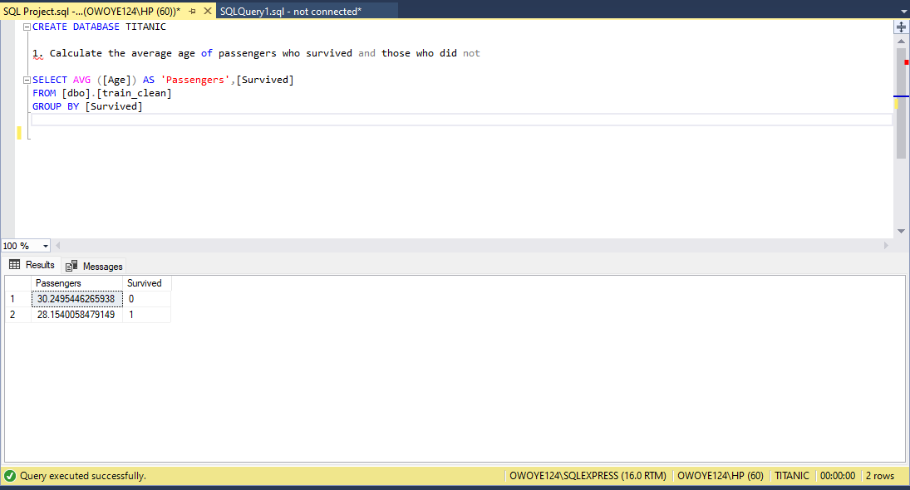

Slide 6
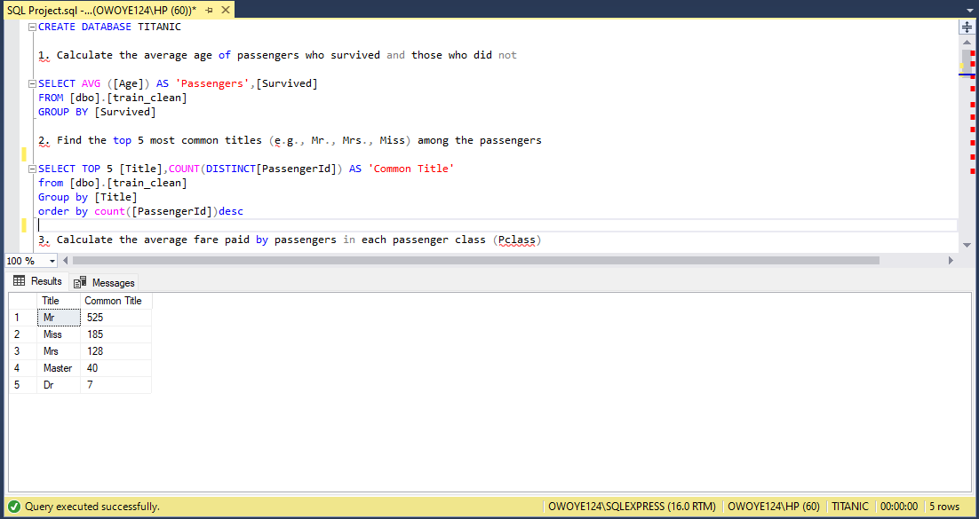

Slide 7
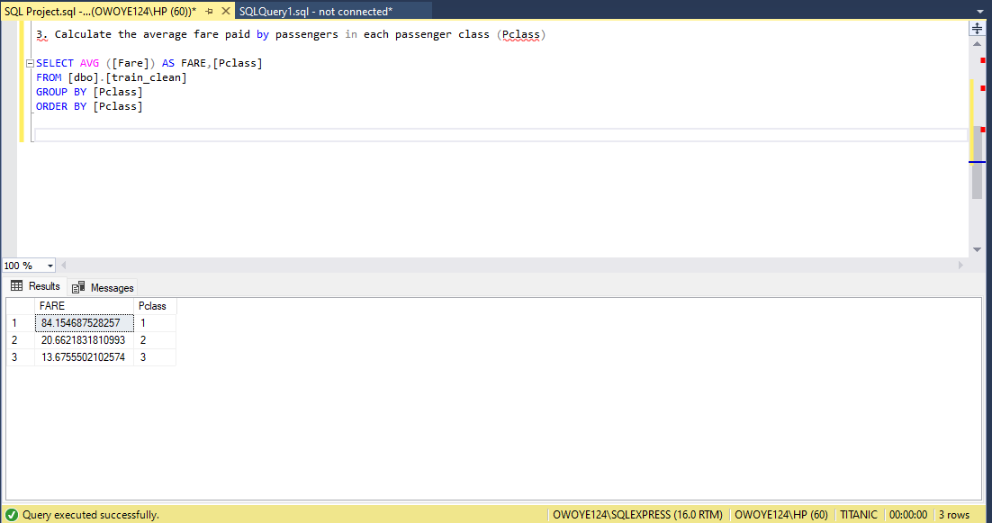

Slide 8
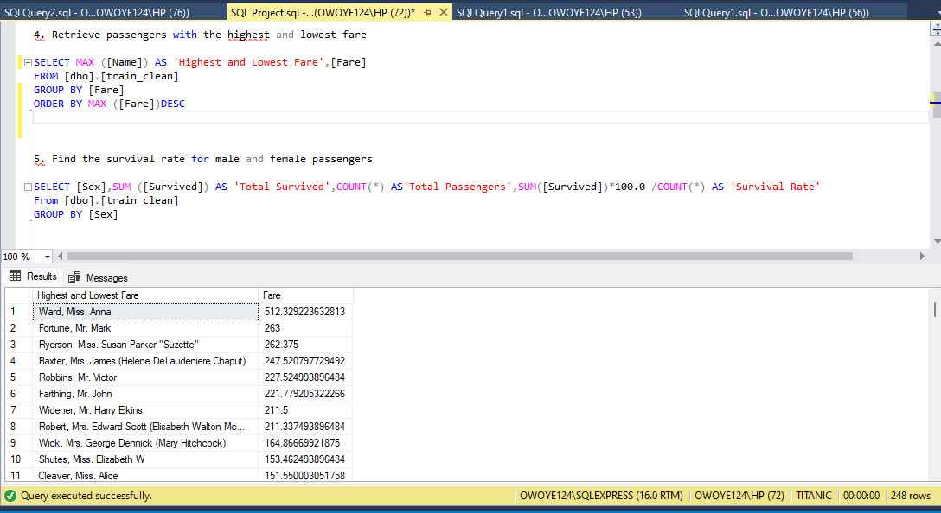

Slide 9
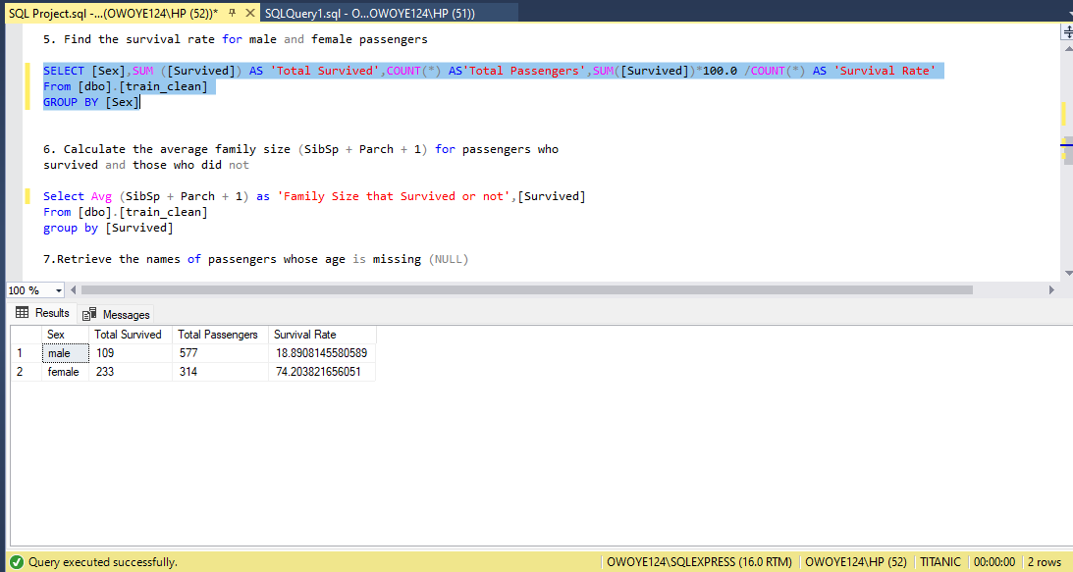

Slide 10
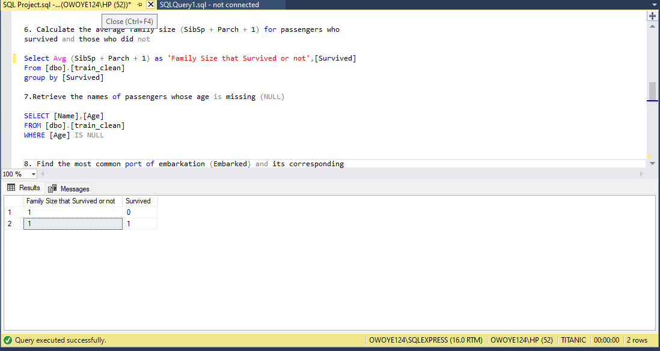

Slide 11
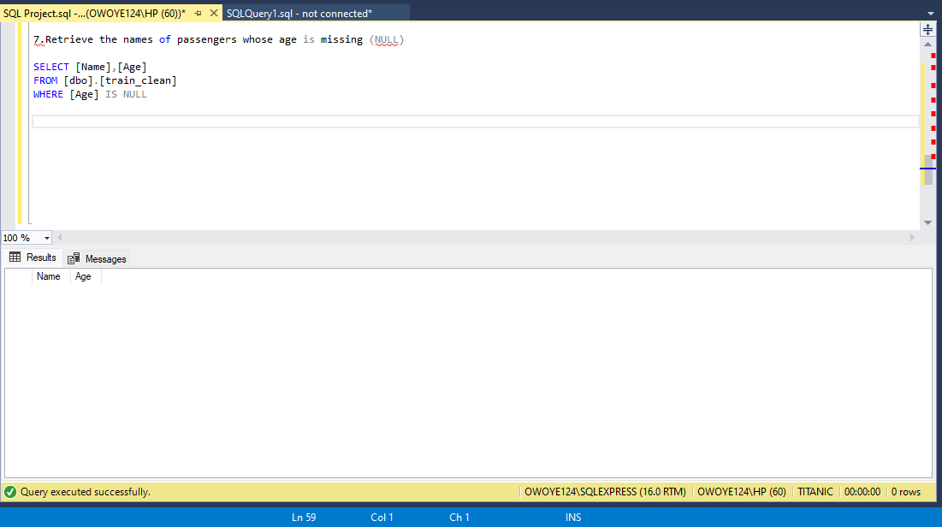

Slide 12
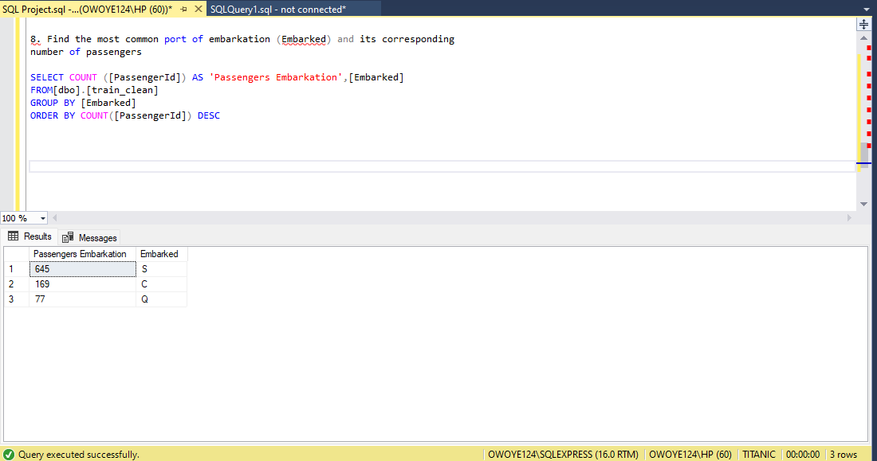

Slide 13
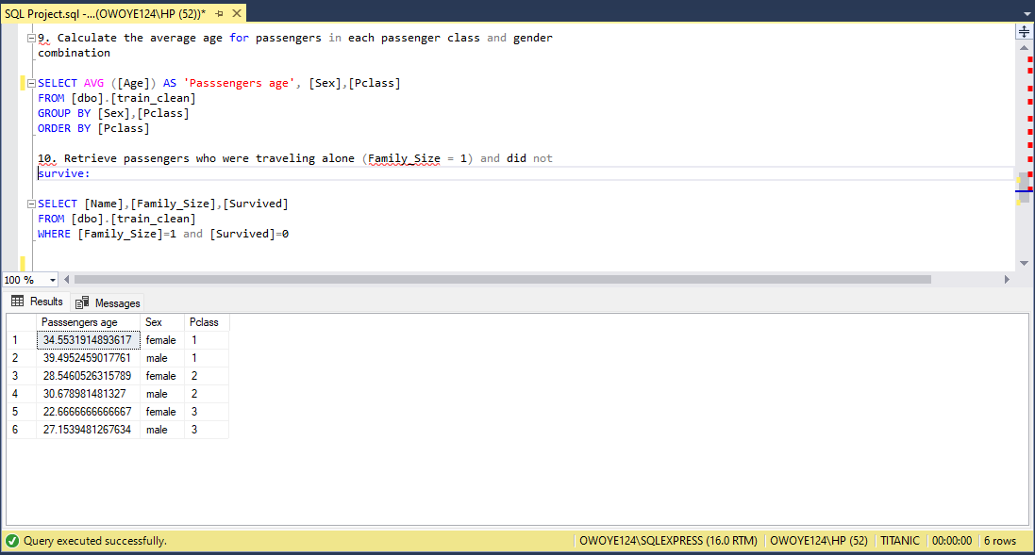
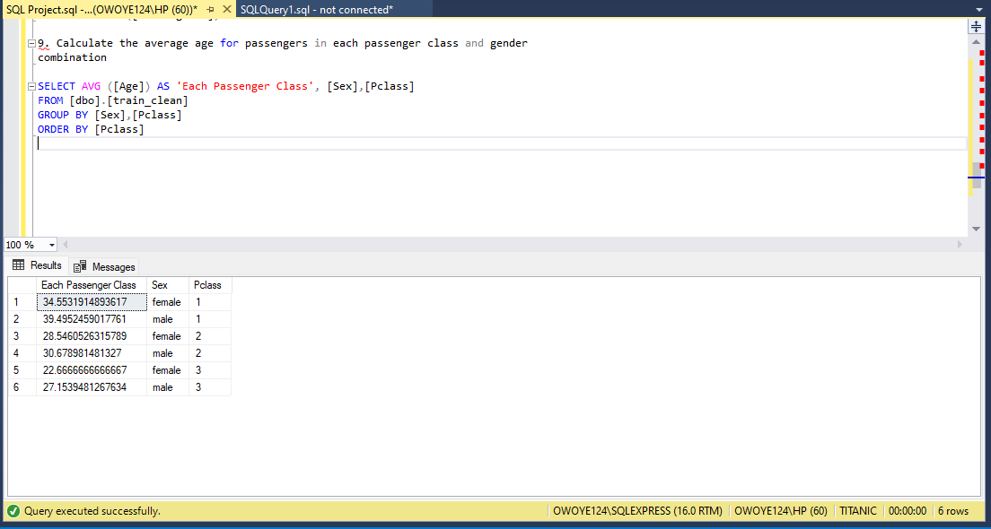

Slide 14
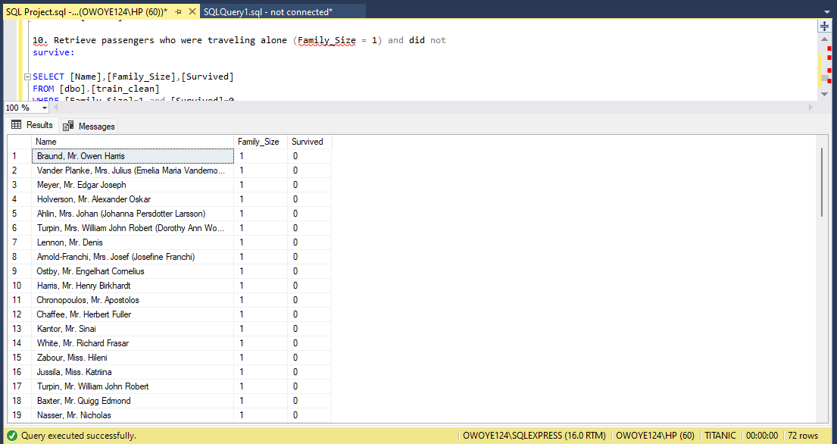

Slide 15
QUESTIONS AND SCREENSHOTTED RESULTS
VISUALIZATION WITH POWER BI

Slide 16
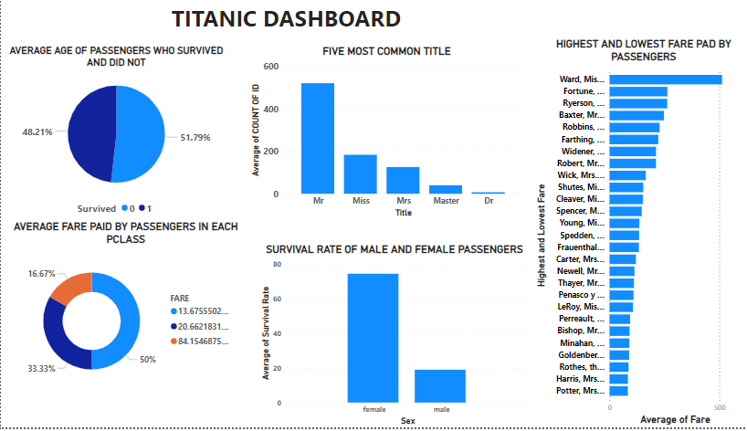

Slide 17
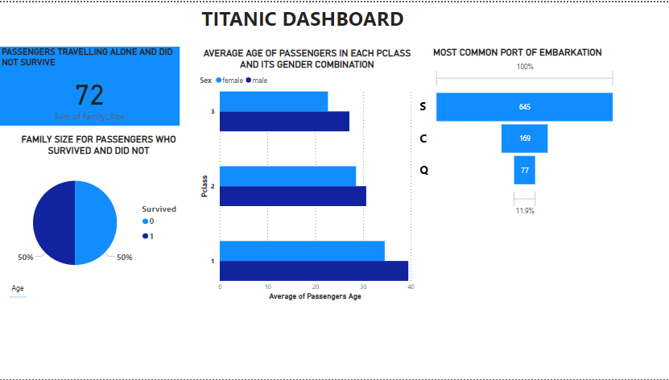

Slide 18
INSIGHT AND RECOMMENDATIONS
From the dashboard, it can be deduced that the deaths were more than survivors, with a death rate of 51.7% and survival rate of 48.2%.
The Females had the highest survival rate of 74.2% on the other hand the males had the least survival rate of 18.9%.
Port S had the highest number of passengers embarkation, with a total of 645 passengers while Port C had 169 and Port Q with 77 respectively.
The total number of males on board was 577, only 109 survived, while 314 females were onboard and 233 survived.
PClass 1 generated the highest fare of 84.5 with the lowest population of 16.63%, while PClass 3 generated the least fare of 13.68 with the highest population of 50%.
The average age of passengers in PClass 1 was 39 Males and 35 Females, PClass 2,had 30 Males and 29 females, and PClass 3 had an average age of 27 Males and 23 Females. . Ages of all passengers were recorded.
To avoid possible high death rate , the ship should be provided with enough Life Jacket for both Passengers and crew members and spares.
There should be constant safety briefings of passengers before boarding to create awareness of what to do in case of emergency.
Sufficient Provision of life boats to accommodate the number of passengers onboard for safe evacuation.
There should be effective ways of communicating unexpected signals of dangers between the Tower watch keeper and the crew on deck.

Slide 19

THANK YOU

